Slide 1

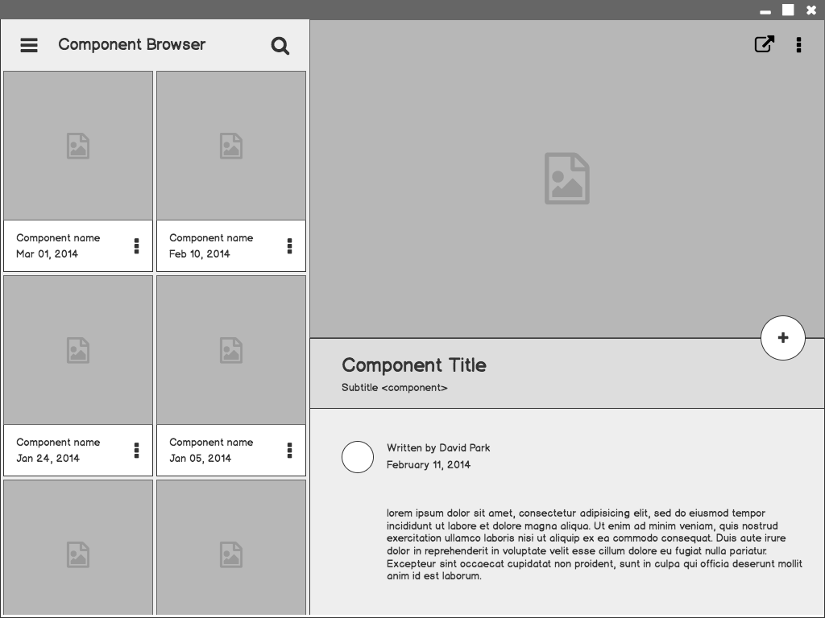
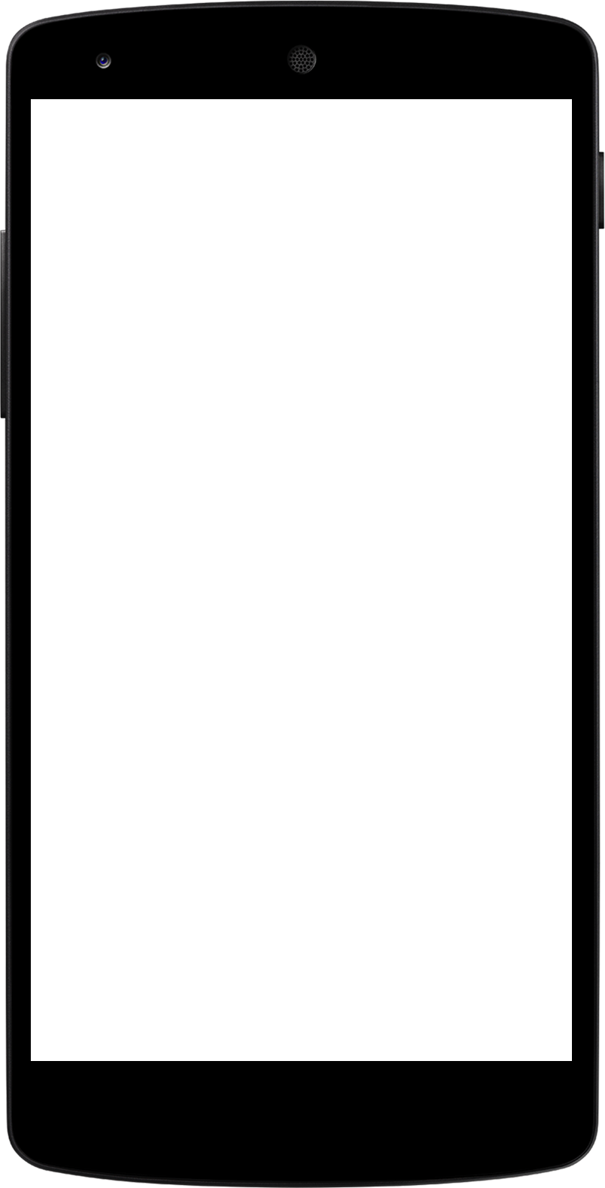
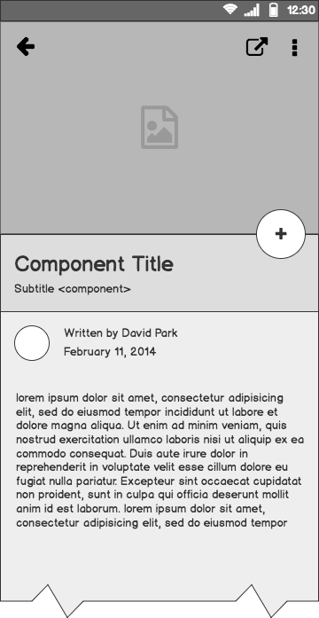
MINI PROJECT 2
USER PERSONA AND WIREFRAMING
A to-do list app for Up and Grateful plc.

Slide 2
Basic User Research
Method Used:
Informal interviews with target users (working professionals & small business owners)
Observation of task organization patterns.
Empathy mapping based on lifestyle constraints.
Questions Asked:
How do you currently organize your daily tasks?
What challenges do you face while managing your to-do list?
What features would make a to-do list app more useful or reliable for you?

Slide 3

User Persona
01
Gender: Female
Occupation: Operations Manager, Product Management Student
Tech Comfort Level: Moderate
Psychographics: Ambitious, driven, detail-oriented, Often overwhelmed by overlapping commitments, Feels guilty when missing deadlines
Goals:Track school and work deliverables, Receive simple, intuitive reminders, Reduce stress from forgotten tasks
Pain Points: Juggling tools creates confusion, Missed deadlines, Apps are often too complex
Behaviours:Checks phone frequently, Uses sticky notes, calendar, Google Keep, Prefers simple UIs with no clutter.
Abbie, 29.
Lagos, Nigeria.

Slide 4

User Persona
02
Gender: Male
Occupation: Owner of Cook-It, a home-based food brand.
Tech Comfort Level: Moderate
Psychographics: Family-oriented, practical, Wants work-life balance, Gets frustrated with tech-heavy apps.
Goals:Timely delivery and order tracking, Remember family obligations, Reduce mental load
Pain Points: Misses tasks while cooking, Paper gets lost; digital apps go unchecked, Doesn’t want to type too much
Behaviours:Uses WhatsApp voice notes, Relies on short-term memory, Prefers apps with fewer clicks
Tunde, 35.
Ibadan, Nigeria.

Slide 5
Features Consideration for wireframe
Key Insights from Research
Users want simplicity and separation of life domains
Reminder notifications must be helpful but not overwhelming
The UI must be minimal and fast
Voice-based task entry is valuable for busy, mobile-first users

Slide 6
Wireframes
Overview of Wireframe Elements
Profile View/Setting Icon: Located at the top right corner
Navigation Bar: Located at the bottom of the screen.Shows Icons for Home (overview of all tasks), Categories (segmented views), Task creation button.
Task Creation Button: Prominently placed at the center bottom (floating action button style). It opens a modal to enter title, due date, time, category (Work, fitness, Personal), and optional note.
Task List View: Default view shows tasks organized by due date.
Task completion progress
Each task item includes: title, due date, checkbox for completion, and category tag.

Slide 7
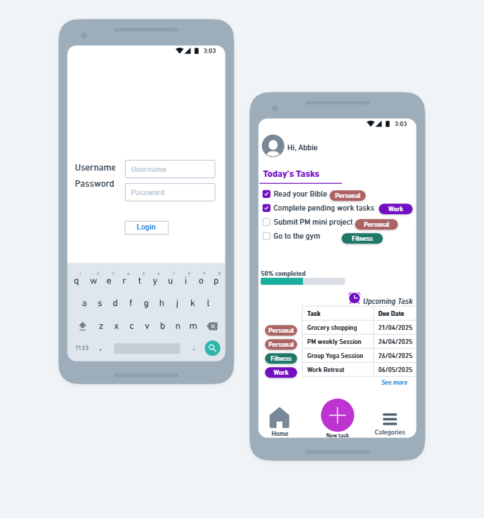
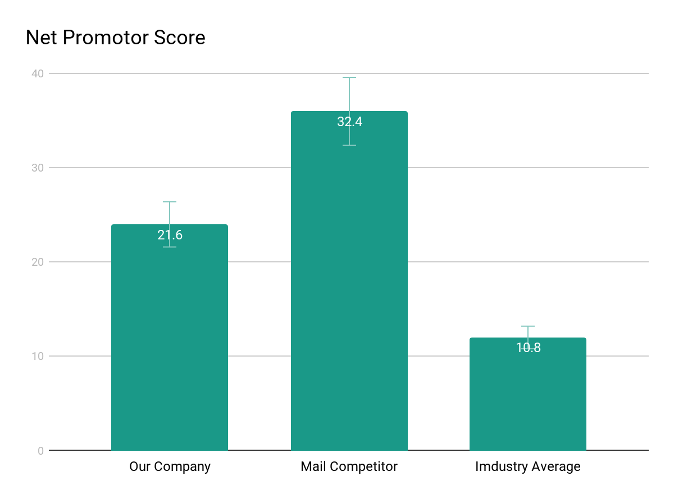
Mobile Wireframe for the TO-DO List App
1

Slide 8
References
Tips for Presenting Your Wireframes
https://whimsical.com/to-do-list-app-ULwiQVBKH88H2b513cVTcv

